Slide 1
FinGenie AI Intelligent Digital Banking & Wealth Management Platform
Presented By: Niveditha H S
Trainer Name : Mr javeed

Slide 2
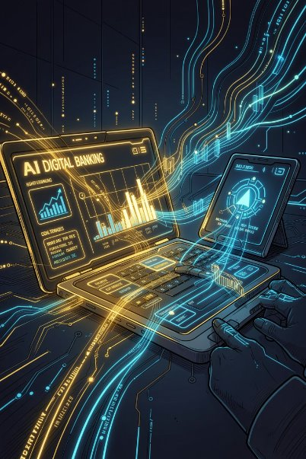
FinGenie AI
AI-Powered Digital Banking Ecosystem

Slide 3
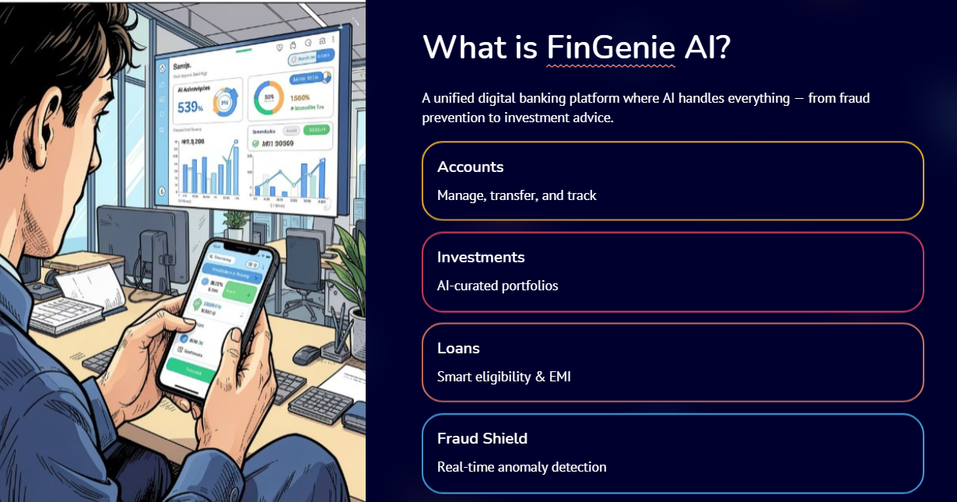

Slide 4
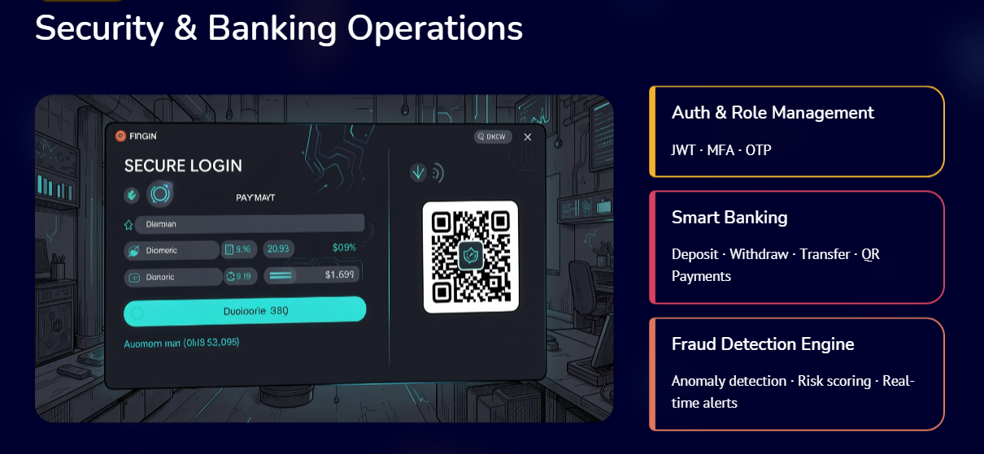

Slide 5
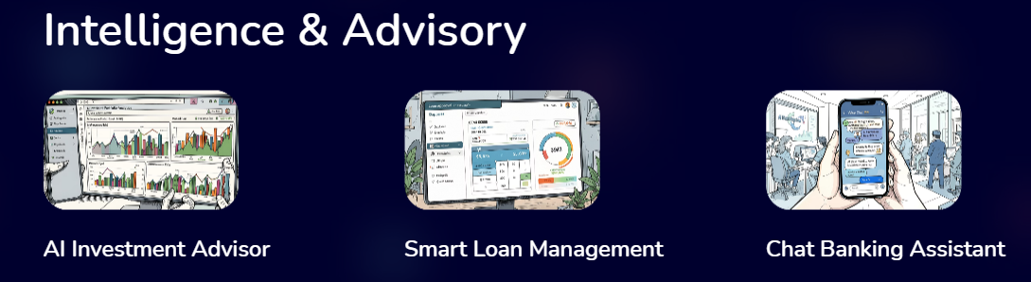

Slide 6


Slide 7
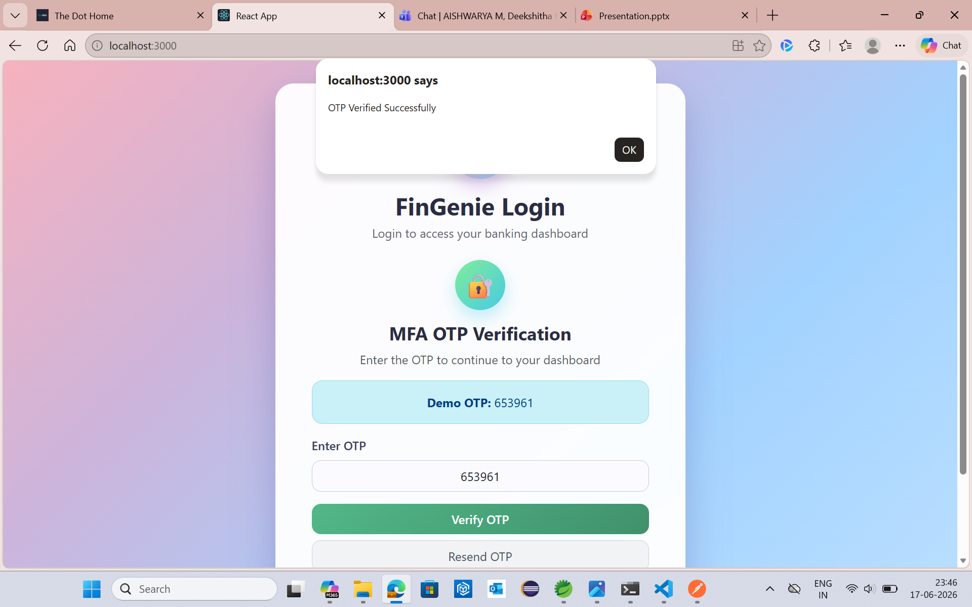
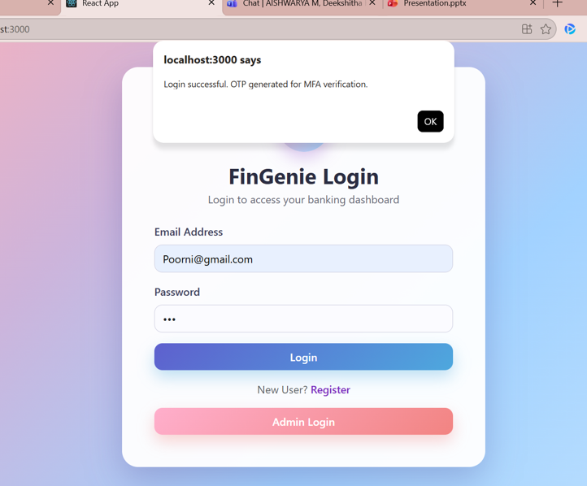

Slide 8
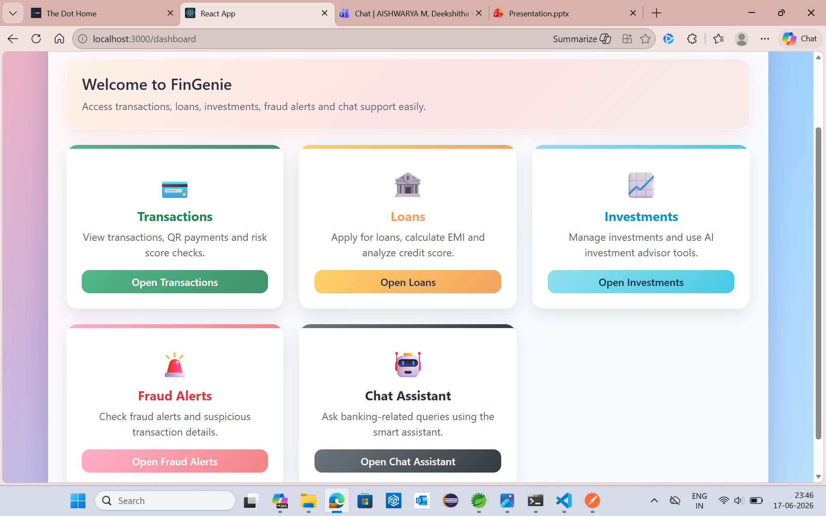

Slide 9
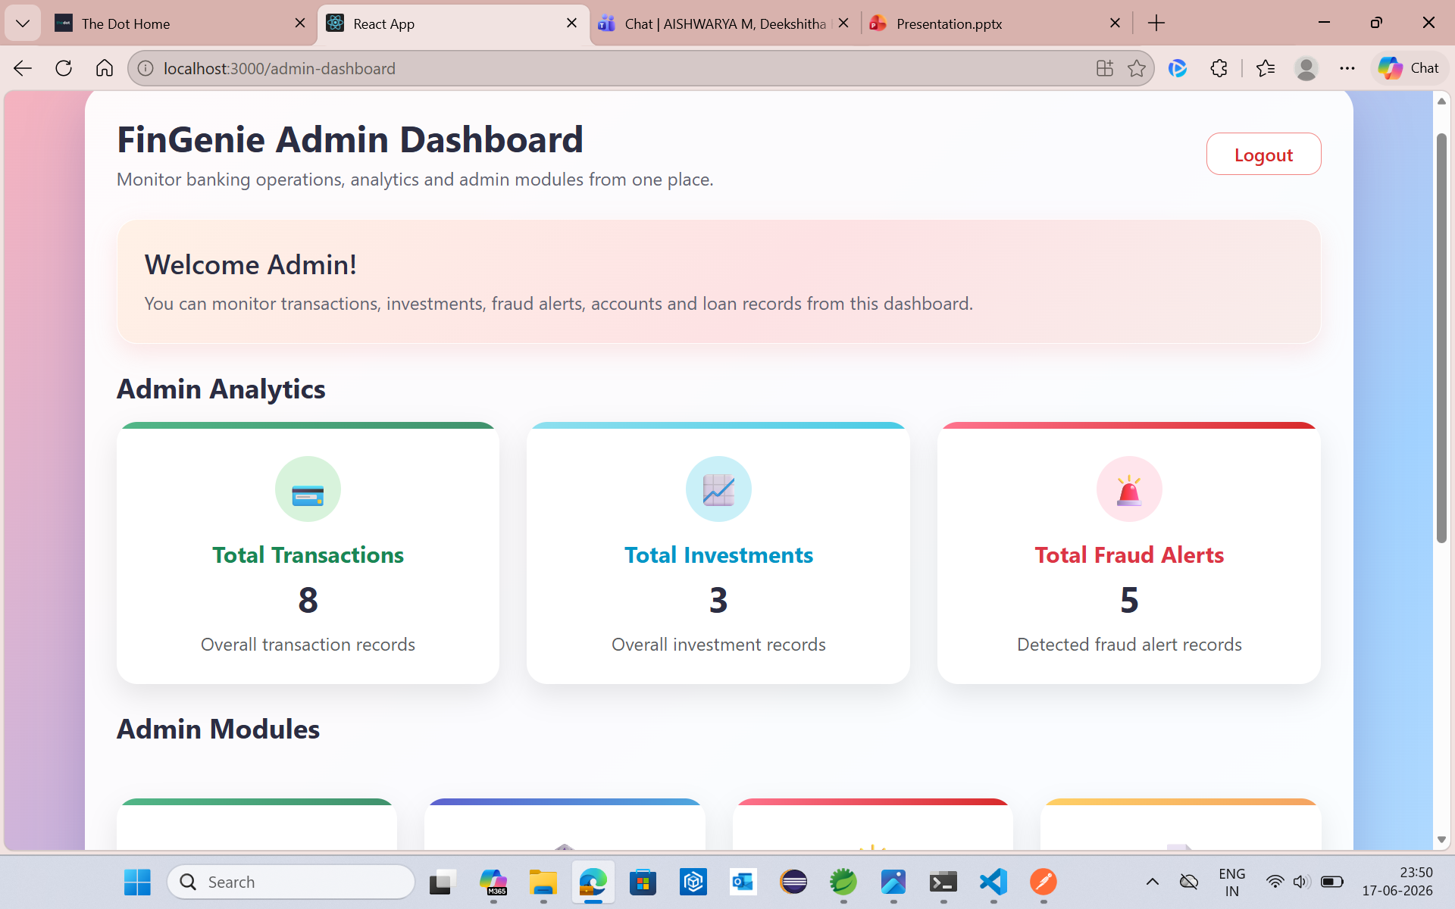

Slide 10
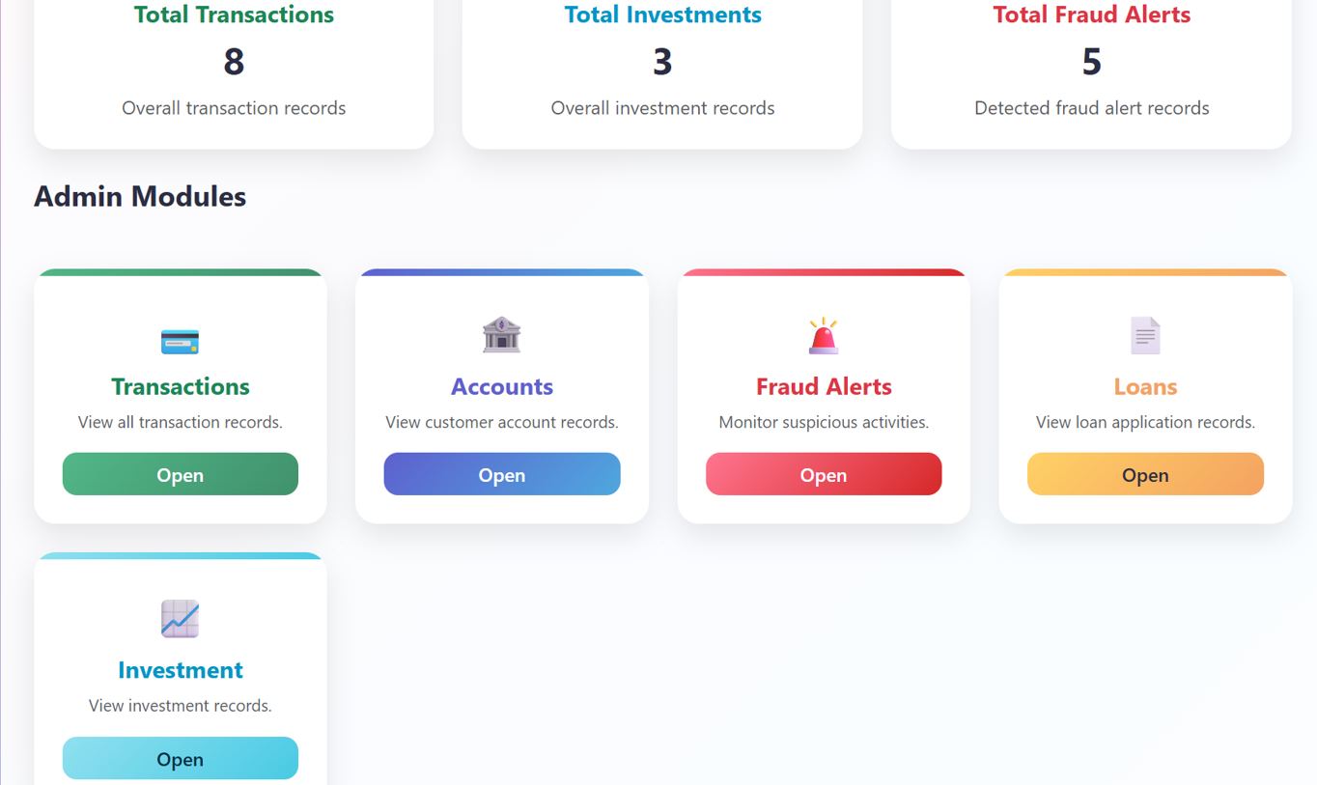

Slide 11


